Slide 1
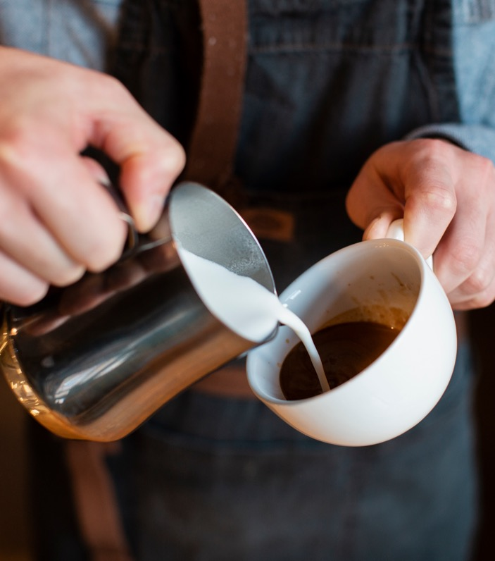

LOCAL BRU
Data Migration to the Cloud
Carrie Cox, Grace Trane, Arun Ganapathy
Notes:
Carrie

Slide 2
TABLE OF CONENTS
01
02
03
04
05
06
Overview
SBAR
Operational
Goals
OKRs
ROI & VOI
Bottom Line Impact
Notes:
Carrie

Slide 3
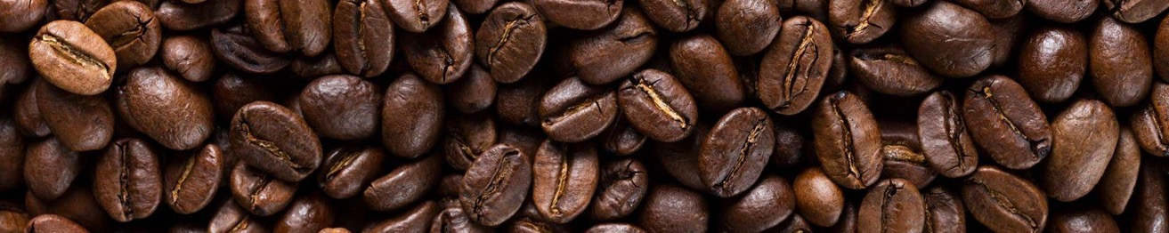
01
Overview
Notes:
Carrie

Slide 4
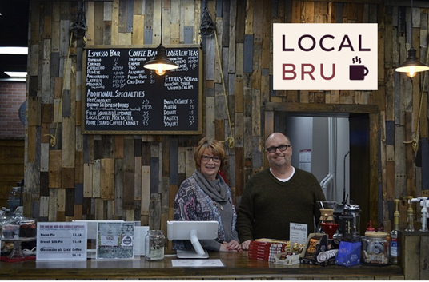
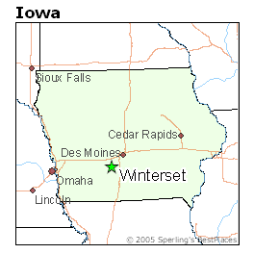

LOCAL BRU
Midwest, regional coffee shop
Opened in 2005 – Winterset, IA
Seen large growth recently, doubling in store count in the last three years
Currently have 50 stores
Partnership with Squarespace for payment system & analytics insights
Notes:
From OKR sheets: Local Bru has seen large growth as a regional coffee shop in the Midwest, doubling our store count over the last three years. Our company must transition from a manual way of determining operations, to using AI intelligent forecasting and optimization in order to create more efficient processes.
Carrie

Slide 5
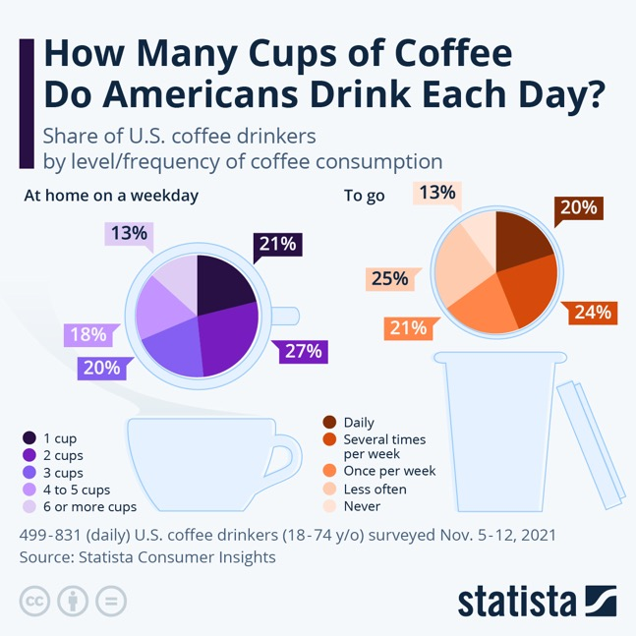
COFFEE INDUSTRY
$85 B
Annual revenue of the US coffee market in 2022
60%
Percentage of Americans who consume coffee daily
38,411
Number of coffee shops across the country in 2021
Source: Statista, 2022; Buchholz 2023
Notes:
Coffee consumption is an everyday habit for 60% of Americans
Carrie

Slide 6
WHAT ARE THE COSTS OF A COFFEEHOUSE?
A small coffee shop owner can expect a take home between $60,000 - $160,000 after expenses. The monthly expenses of operating likely total 75-85% of monthly sales. For Local Bru to continue to improve, and beat the average, we need to have better control of our expenses.
Coffee industry best practices
% of Sales | Typical Range | Best Practice
Cost | 35-40% | 30-35%
Labor | 30-40% | 25-30%
Rent | 10-15% | < 10%
Source: Toast POS, 2022; Seven Miles, 2018
Notes:
Monthly expenses – including average coffee shop experiencing around $5,000 in annual material waste
Thus, our problem identified is to <SBAR>
Carrie

Slide 7

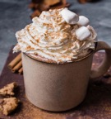


INVESTMENT OPPORTUNITY
Since the COVID-19 Pandemic, coffee shops have faced:
Labor shortages
High labor costs
Increased costs of goods
Given the recent shift in the industry, the company must transition from a manual way of determining operations, to migrating entirely to the cloud and using intelligent AI forecasting and optimization to create more efficient processes.
The best brew is local. We're growing – check out our new locations!
Notes:
Carrie

Slide 8
02
SBAR Situation, Background, Assessment, Recommendation
Notes:
Arun

Slide 9

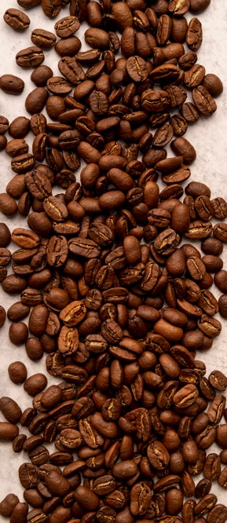

LOCAL BRU SBAR
Situation
Background
Improve Revenue
Manual data entry
Lack of efficient inventory planning
Lack of knowledge in optimizing labor
Limited knowledge of consumer preferences
Assessment
Recommendation
The introduction of a cloud-based data warehouse will provide data ownership with one source of truth
Migrate to cloud-based solution
Utilize AI to obtain better control over cost of goods, inventory, and labor
Notes:
The subject is to improve revenue – through better control over our data and utilization of AI – including control over Cost of Goods, scheduling, and increased capacity (more customers in less time with improved efficiencies)
Arun

Slide 10
03
Operational Goals
Notes:
Arun

Slide 11
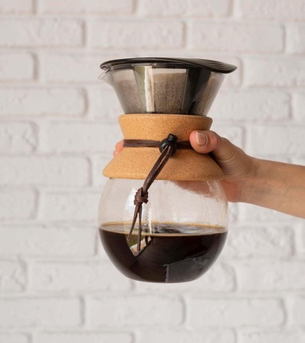
OPERATIONAL GOALS
Centralized Data
Enhanced Data Analytics
Annual Data Governance Re-trainings
Annual Security Reviews
Notes:
Centralized Data
Easy and consistent data access
Enhanced data analytics
Usage views, data/consumer insights
Data governance
Data dictionary
Security reviews
Role hierarchy
Ongoing security reviews to stay updated

Slide 12
04
Objectives & Key Results
Notes:
Arun

Slide 13



LOCAL BRU OBJECTIVES
Enhance Forecasting Accuracy
Optimize resource allocation and utilization
Improve
on-time delivery
Notes:
Arun

Slide 14
Transforming Forecasting, Delivery and Resource Optimization for Operational Excellence
Objective | Key Result | Owner | Target
Enhance forecasting accuracy | Improve product pricing through use of AI intelligent forecasting of cost of goods, improving net profit margin from 8% to 10% | Materials Manager | End Q2 '24
 | Use AI intelligent forecasting to optimally budget marketing advertisement spendings based on regional performance, increasing monthly new customer traffic from 5% to 8% | Marketing Manager | End Q2 '24
Optimize resource allocation and utilization | Improve shift scheduling by decreasing published schedule changes from 15% to 10% | Regional Store Manager | End Q4 '24
 | Reduce product waste from 20% to 15%, utilize AI and optimization techniques to monitor product consumption & inventory | Materials Manager | End Q4 '24
Improve on-time delivery | Enhance order creation time by reducing average order completion time by 20% (5 minutes to 4 minutes) by developing drink creation standards/workflow | Regional Store Manager | End Q2 '24
 | Optimize coffee bean product delivery to local stores (delivering too much, too often, or non-popular items) to improve retail sales from 5% to 10% of total sales | Marketing Manager | End Q4 '24
Source: Toast POS, 2022
Notes:
Arun

Slide 15
05
ROI & VOI
Notes:
Grace

Slide 16

INITAL INVESTMENT: $300,000
Migrate to an Azure Cloud platform
$100k
Develop and integrate AI forecasting and optimization tools
$200k
Notes:
Grace

Slide 17
BENEFITS: ROI
CATEGORY | RETURN ON INVESTMENT | POSITIVE FINANCIAL EXPECTATIONS
Revenue Growth | Improve net profit margins from 8% to 10% | By using AI intelligent forecasting, we can accurately price products and increase revenue by $125,000 annually.
Revenue Growth | Improve retail sales of coffee beans from 5% to 10% | With the ability to optimize our delivery of coffee beans to local stores, we will see an increase in annual sales of $25,000.
Cost Control / Operational Efficiency | Decrease published schedule changes from 15% to 10% | We are expecting to decrease operational costs by $37,500 annually due to published schedule changes.
Cost Control / Inventory Management | Reduce product waste from 20% to 15% | By utilizing our sales data and AI, we can monitor inventory turnover and reduce product waste to save $25,000 annually.
Cloud Migration / Technology Investments | Migrate Square data to a cloud-based platform | We project cost savings of $50,000 annually by streamlining data management and reducing on-premises infrastructure costs.
Source: Toast POS, 2022
Notes:
Grace

Slide 18
BENEFITS: VOI
CATEGORY | VALUE ON INVESTMENT | POSITIVE VALUE EXPECTATIONS
Revenue Growth / Marketing | Assess the effectiveness of marketing campaigns (social media, advertising, and promotions) in driving new customers and increasing sales | By achieving a more efficient allocation of resources and targeting strategies, we anticipate an annual increase in sales of $87,500.
Revenue Growth / Customer Satisfaction | Increase monthly new customer traffic from 5% to 8% | With the ability to analyze consumer purchasing behavior in Local Brus sales data, we can increase consumer traffic and see an annual increase in sales of $75,000.
Revenue Growth / Customer Satisfaction | Reduce average order completion time by 20% (5 to 4 minutes), increasing customer satisfaction through quality and timeliness of orders | By streamlining operations and standards to reduce labor costs and improve service speed, we will save $62,500 in labor costs annually.
Source: Toast POS, 2022
Notes:
Grace

Slide 19
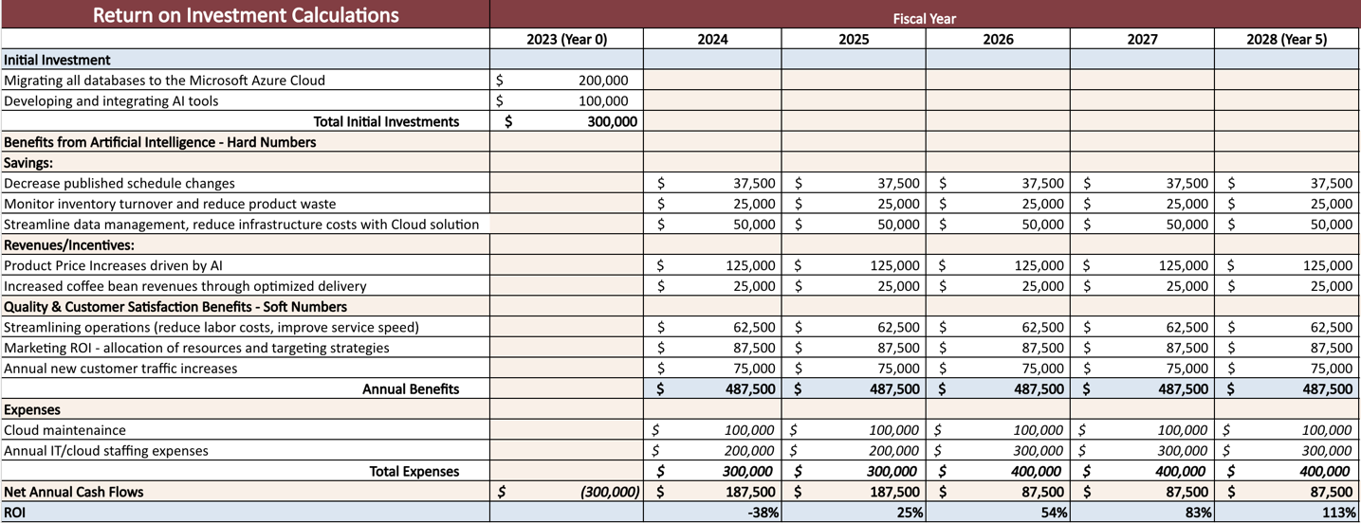
CALCULATIONS
Source: “Pricing Calculator: Microsoft Azure”, “Cost of Ownership: Microsoft Azure”.
Notes:
Grace

Slide 20
06
Bottom Line Impact
Notes:
Grace

Slide 21

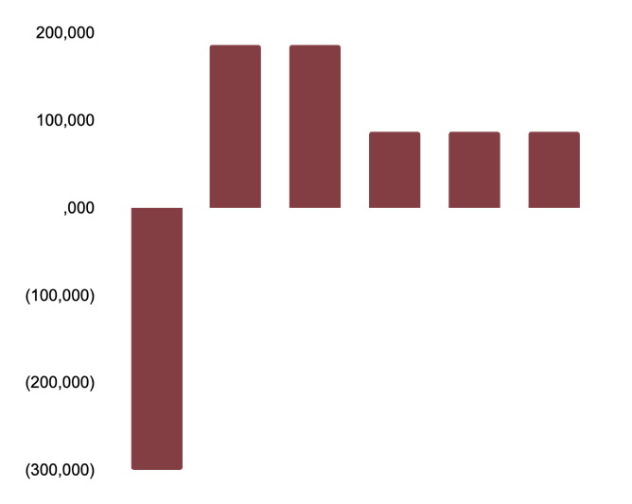
OUR BREAKING POINT
PAYBACK
300,000
1.6 yrs.
We expect a payback after 1.6 years
5-YEAR ROI
113%
Net Cash Flow ($)
Our initial investment is expected to pay for itself and bring a net profit of 113% of the investment made
40%
Internal Rate of Return (IRR)
Our expected increases in profitability after five years
2023
2024
2025
2026
2027
2028
Notes:
Grace

Slide 22
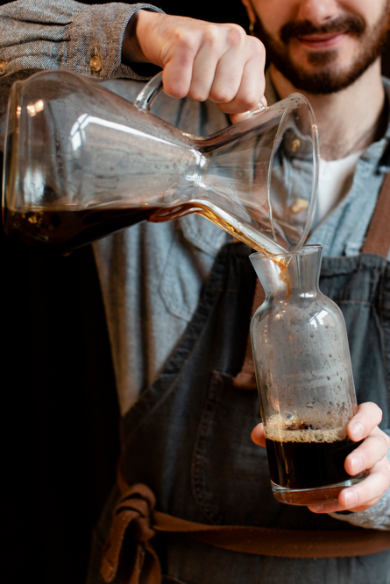
FINAL SUMMARY
Cloud Migration and AI Forecasting & Optimization will drive growth for Local Bru
With the investment of $300,000, Local Bru will gain better control over our expenses and expect to break-even in just 1.6 years
Notes:
Grace

Slide 23
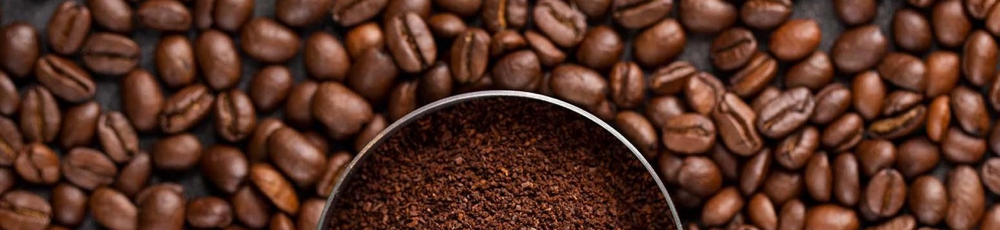
Questions?
Notes:
Grace

Slide 24
Works Cited
Statista. "Coffee shops and cafes in the U.S. - statistics & facts." 2022, https://www.statista.com/topics/1670/coffeehouse-chain-market/#topicOverview.
Statista. "Coffee market in the U.S." 2022, https://www.statista.com/forecasts/758662/revenue-of-the-coffee-market-worldwide-by-country.
Buchholz, Katharina. "How Many Cups of Coffee Do Americans Drink Each Day?" Statista, 2023, https://www.statista.com/chart/19524/cups-of-coffee-drunk-by-americans-per-day/.
Toast POS. "How Much Do Coffee Shops Make?" 2022, https://pos.toasttab.com/blog/on-the-line/how-much-do-coffee-shops-make.
Seven Miles. "5 Ways to Improve Cafe Profit." 2018, https://www.sevenmiles.com.au/blogs/editorial/5-ways-to-improve-cafe-profit.
“Pricing Calculator”. Microsoft Azure, https://azure.microsoft.com/en-us/pricing/calculator/.
“Cost of Ownership”. Microsoft Azure, https://azure.microsoft.com/en-us/pricing/tco/calculator/.
Credits: This presentation template was created by Slidesgo, including icons by Flaticon, infographics & images by Freepik

